Slide 1
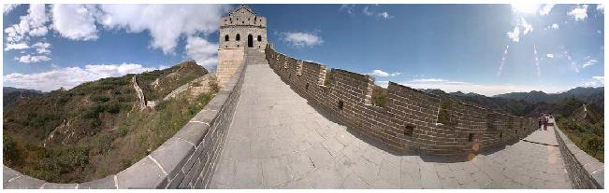
Image Stitching

Slide 2
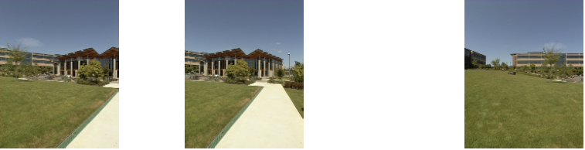
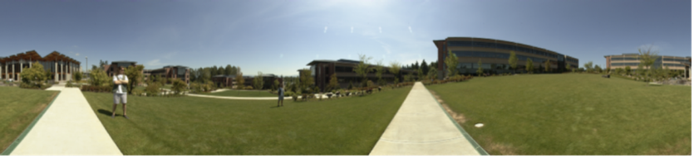
Image Mosaics
+ + … + =
Goal: Stitch together several images into a seamless composite

Slide 3
Outline
Align the images over each other
Finding feature points
Creating descriptors
Feature matching
Finding relative “transformation”
Blend the images together
Image blending

Slide 4
Outline
Align the images over each other
Finding feature points
Creating descriptors
Feature matching
Finding relative “transformation”
Blend the images together
Image blending
Covered in the previous class

Slide 5
A pencil of rays contains all views
real
camera
synthetic
camera
Can generate any synthetic camera view
as long as it has the same center of projection!

Slide 6
2D Rotational
real 1 & synthetic
camera
real 2
camera

Slide 7
2D Translation + 2D Rotation
real 1 & synthetic
camera
real 2
camera

Slide 8
Finding relative “transformation”
What is the relative transformation
In image (2D) space?
In world (3D) space?
What kind of camera motion allowed between two pictures?
Motion model

Slide 9
Motion models

Slide 10
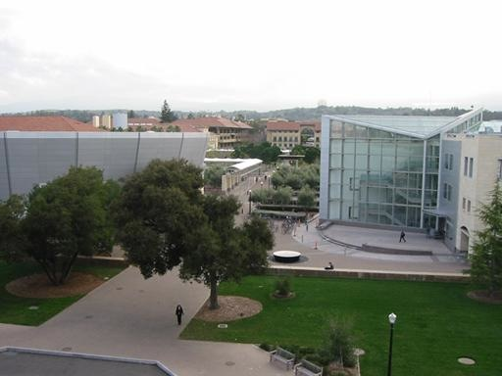
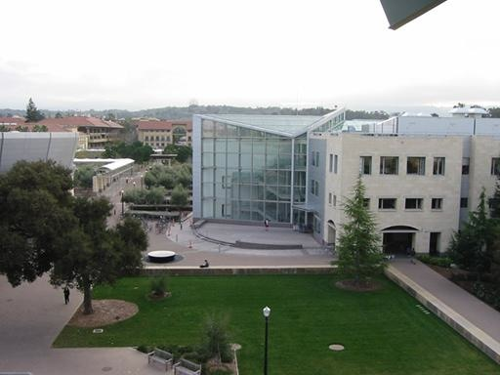
Motion models
What happens when we take two images with a camera and try to align them?
translation?
rotation?
scale?
affine?
perspective?

Slide 11
A pencil of rays contains all views
real
camera
synthetic
camera
Can generate any synthetic camera view
as long as it has the same center of projection!

Slide 12
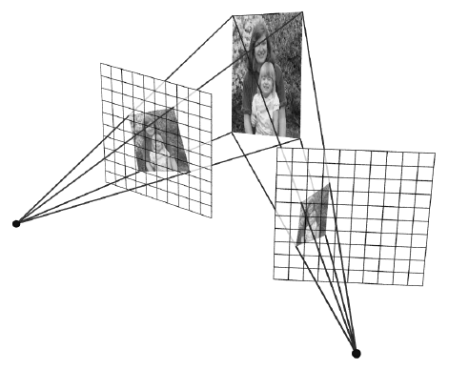
Planar scene (or a faraway one)
PP3
PP1
PP2
PP3 is a projection plane of both centers of projection, so we are OK!
This is how big aerial photographs are made

Slide 13
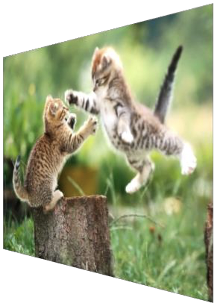
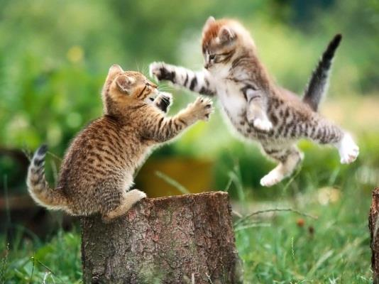
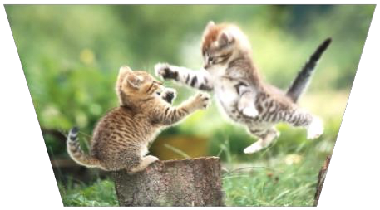
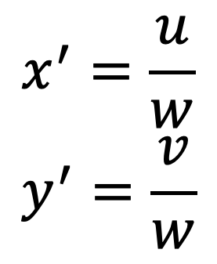
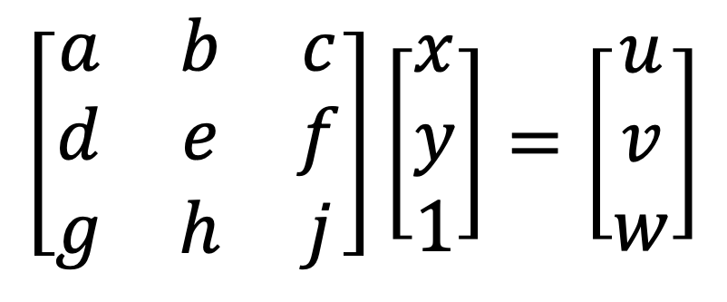
Projective transformations
Homographies
$$x^{′}=\frac{u}{w} \\ y^{′}=\frac{v}{w}$$
$$\left[\begin{matrix}a & b & c \\ d & e & f \\ g & h & j\end{matrix}\right]\left[\begin{matrix}x \\ y \\ 1\end{matrix}\right]=\left[\begin{matrix}u \\ v \\ w\end{matrix}\right]$$
“keystone” distortions

Slide 14
Changing camera center
synthetic PP
Does it still work?
PP1
PP2

Slide 15
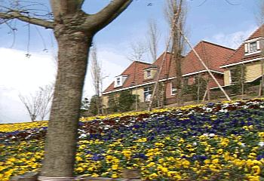
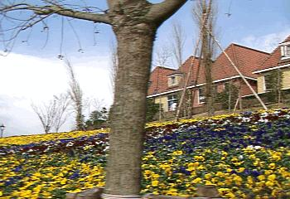
What cannot
The scene with depth variations and the camera has movement

Slide 16
Image Warping

Slide 17
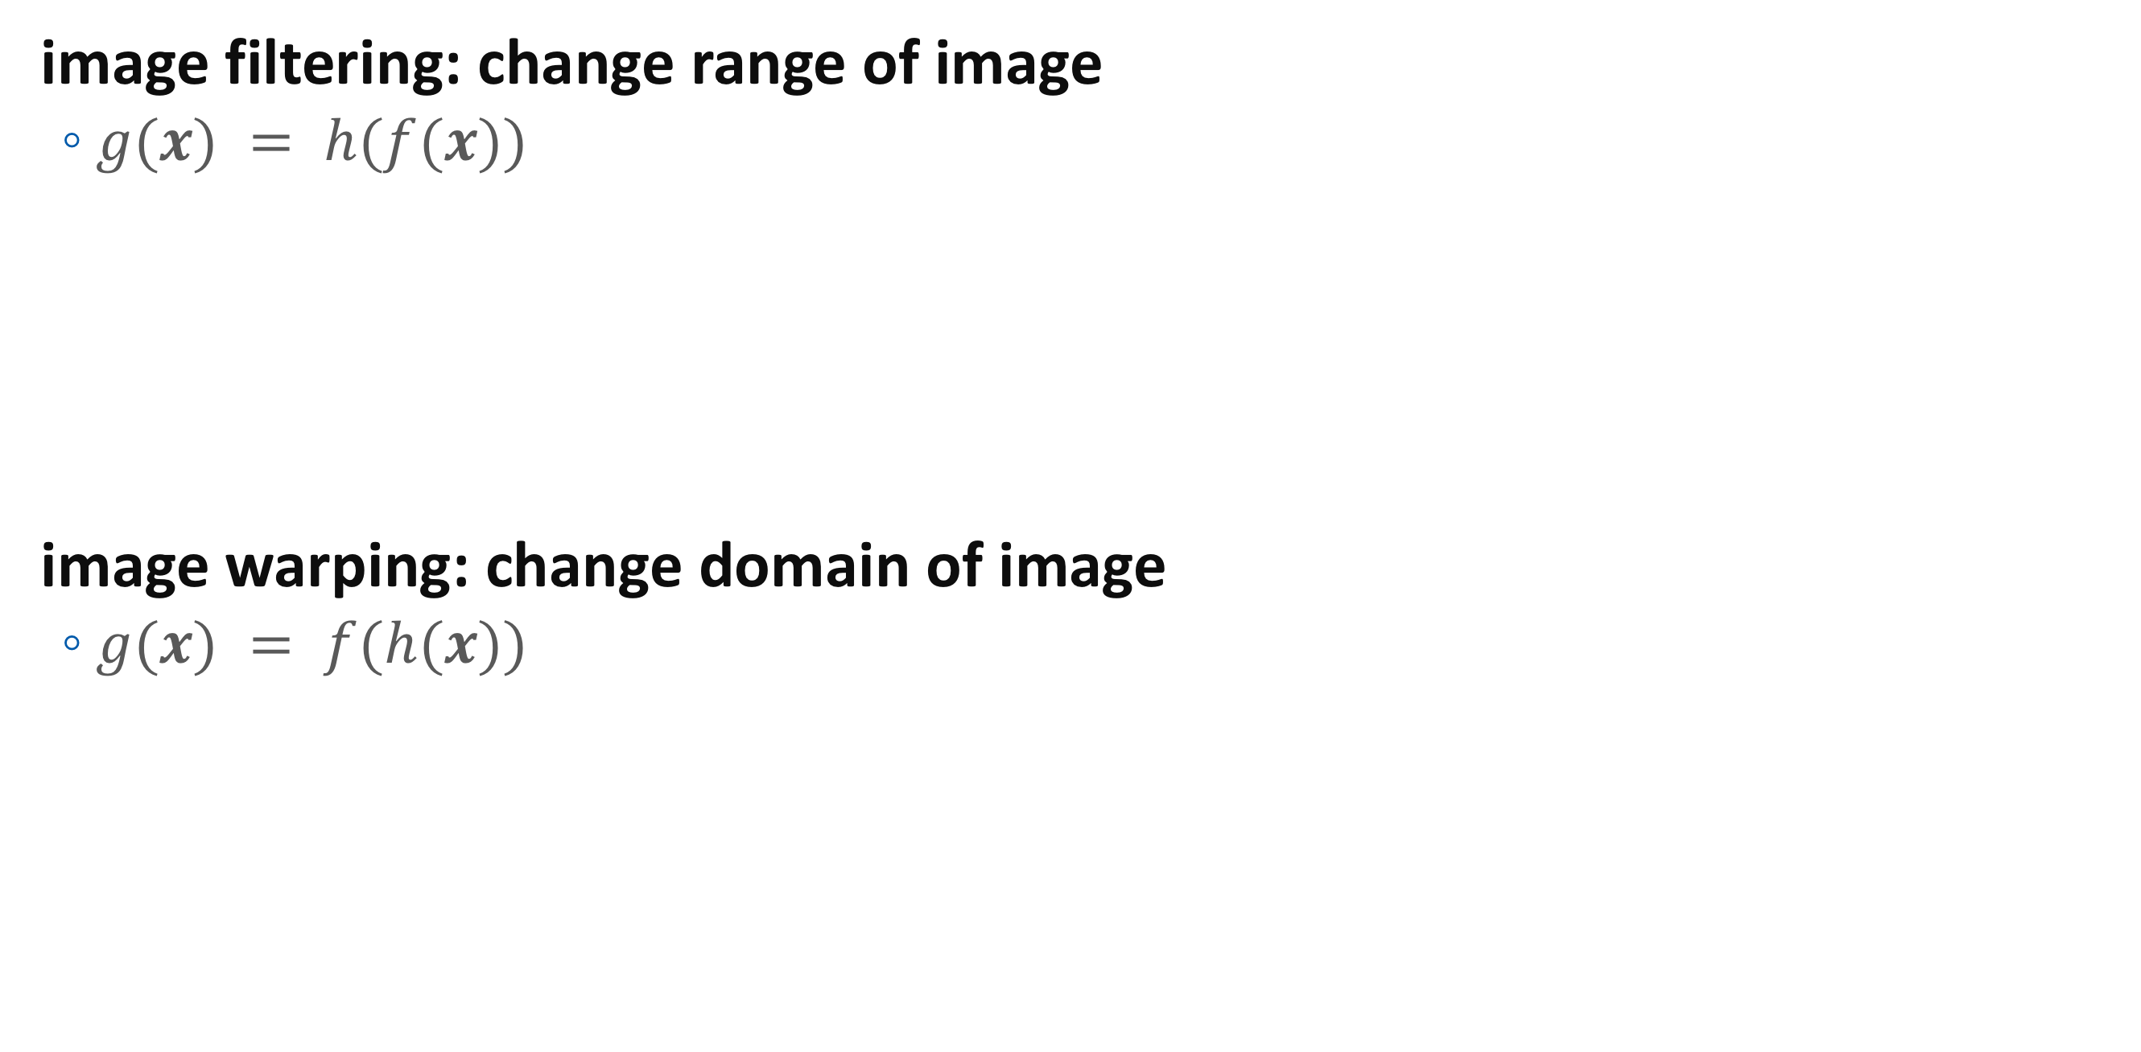
Image Warping
image filtering: change range of image
$g(x) = h(f(x))$
image warping: change domain of image
$g(x) = f(h(x))$
f
f
h
x
x
f
f
h
x
x

Slide 18
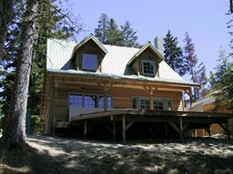
Image Warping
image filtering: change range of image
$g(x) = h(f(x))$
image warping: change domain of image
$g(x) = f(h(x))$
f
g
h
f
g
h

Slide 19
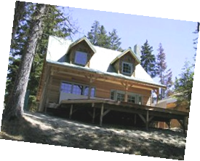
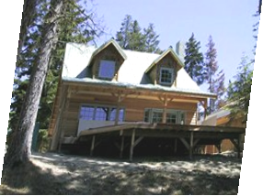
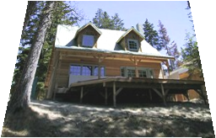
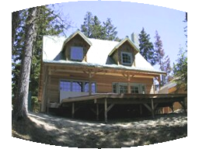
Parametric (global) warping
Examples of parametric warps:
translation
rotation
aspect
perspective
affine
cylindrical

Slide 20
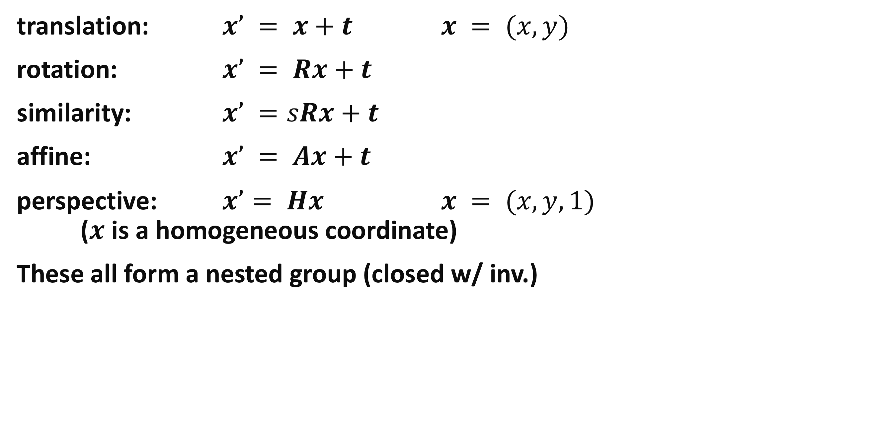
2D coordinate transformations
translation: $x’ = x+t$ $x = (x,y)$
rotation: $x’ = Rx+t$
similarity: $x’ =sRx+t$
affine: $x’ = Ax+t$
perspective: $x’= Hx$ $x = (x,y,1)$ ($x$ is a homogeneous coordinate)
These all form a nested group (closed w/ inv.)

Slide 21
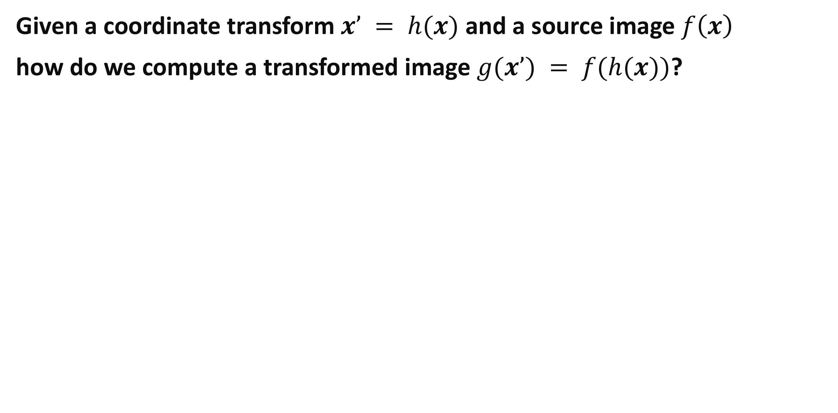
Image Warping
Given a coordinate transform $x’ = h(x)$ and a source image $f\left(x\right)$
how do we compute a transformed image $g(x’) = f(h(x))$?
h(x)
x
x’
f(x)
g(x’)

Slide 22
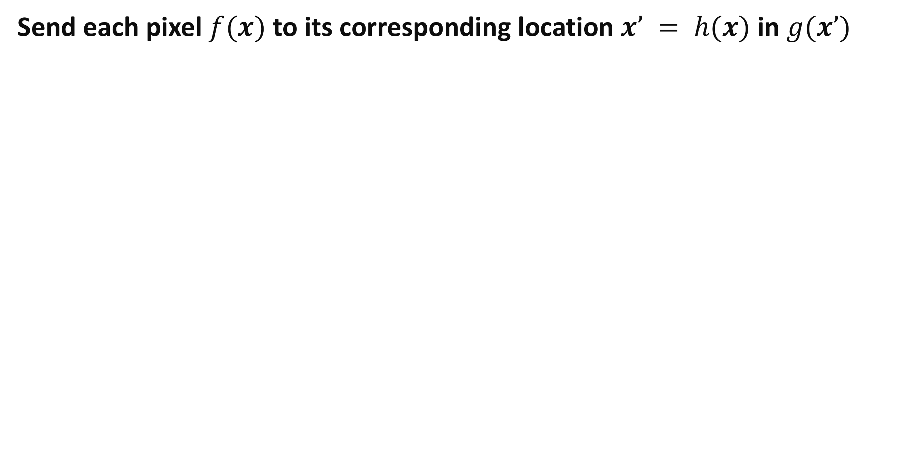
Forward Warping
Send each pixel $f(x)$ to its corresponding location $x’ = h(x)$ in $g(x’)$
What if pixel lands “between” two pixels?
h(x)
x
x’
f(x)
g(x’)

Slide 23
Forward Warping
Send each pixel $f(x)$ to its corresponding location $x’ = h(x)$ in $g(x’)$
What if pixel lands “between” two pixels?
Answer: add “contribution” to several pixels, normalize later (splatting)
h(x)
x
x’
f(x)
g(x’)

Slide 24
Inverse Warping
Send each pixel $f(x)$ to its corresponding location $x’ = h(x)$ in $g(x’)$
What if pixel comes from “between” two pixels?
h(x)
x
x’
f(x)
g(x’)

Slide 25
Inverse Warping
Get each pixel g(x’) from its corresponding location x’ = h(x) in f(x)
What if pixel comes from “between” two pixels?
Answer: resample color value from interpolated (prefiltered) source image
x
x’
f(x)
g(x’)

Slide 26
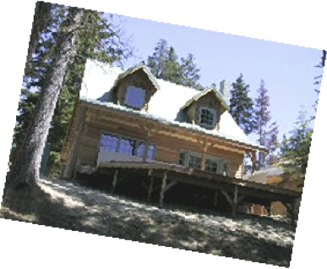
Interpolation
Possible interpolation filters:
nearest neighbor
bilinear
bicubic (interpolating)
sinc / FIR
Needed to prevent “jaggies” and “texture crawl”

Slide 27
Motion models (reprise)

Slide 28
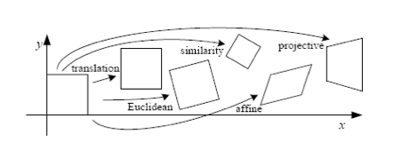
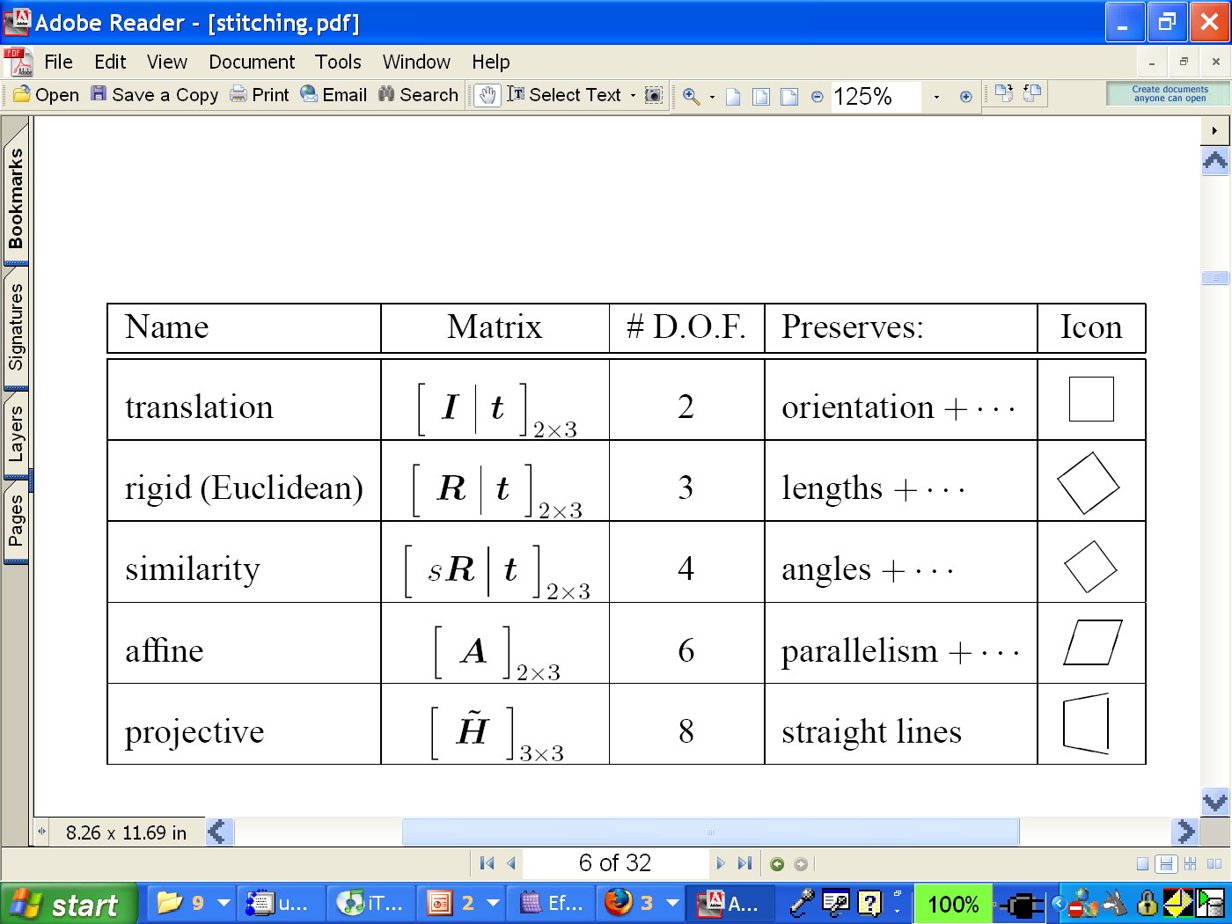
Motion models

Slide 29
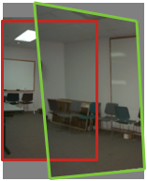
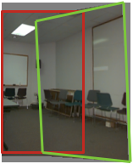
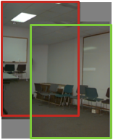
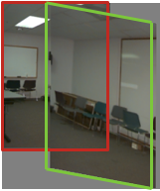
Motion models
Translation
Affine
Perspective
3D rotation
2 unknowns
6 unknowns
8 unknowns
3 unknowns

Slide 30
Finding the transformation
Transition = 2 degree of freedom
Similarity = 4 degree of freedom
Affine = 6 degree of freedom
Homography = 8 degree of freedom
How many corresponding point do we need to solve?

Slide 31
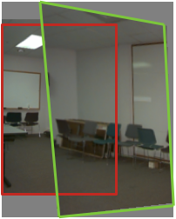
Plane perspective mosaics
8-parameter generalization of affine motion
works for pure rotation or planar surfaces
Limitations:
local minima
slow convergence
difficult to control interactively

Slide 32
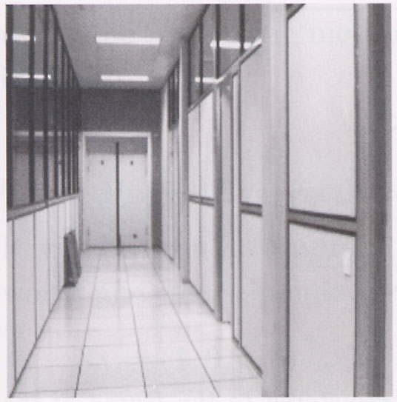
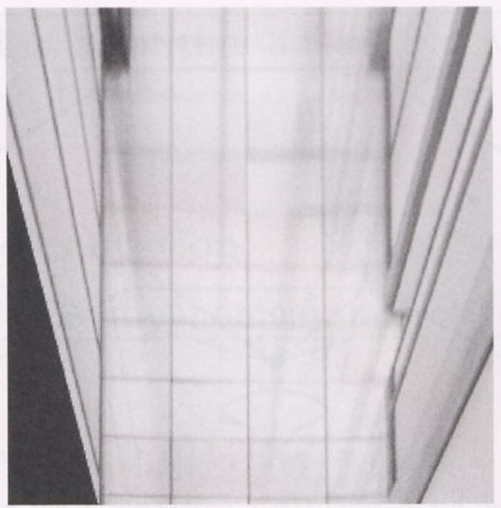
Image warping with homographies
image plane in front
image plane below

Slide 33
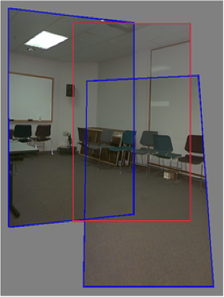
Rotational mosaics
Directly optimize rotation and focal length
Advantages:
ability to build full-view panoramas
easier to control interactively
more stable and accurate estimates

Slide 34
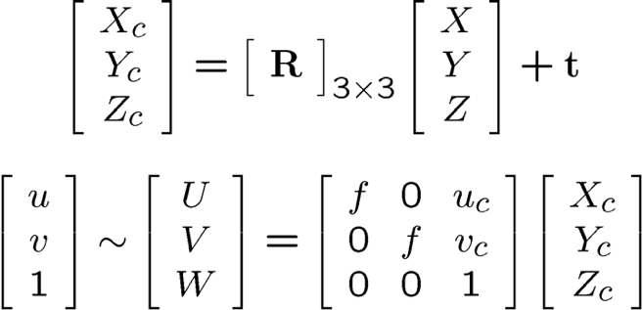
3D → 2D Perspective Projection
(X_{c},Y_{c},Z_{c})
f
u_{c}
u

Slide 35
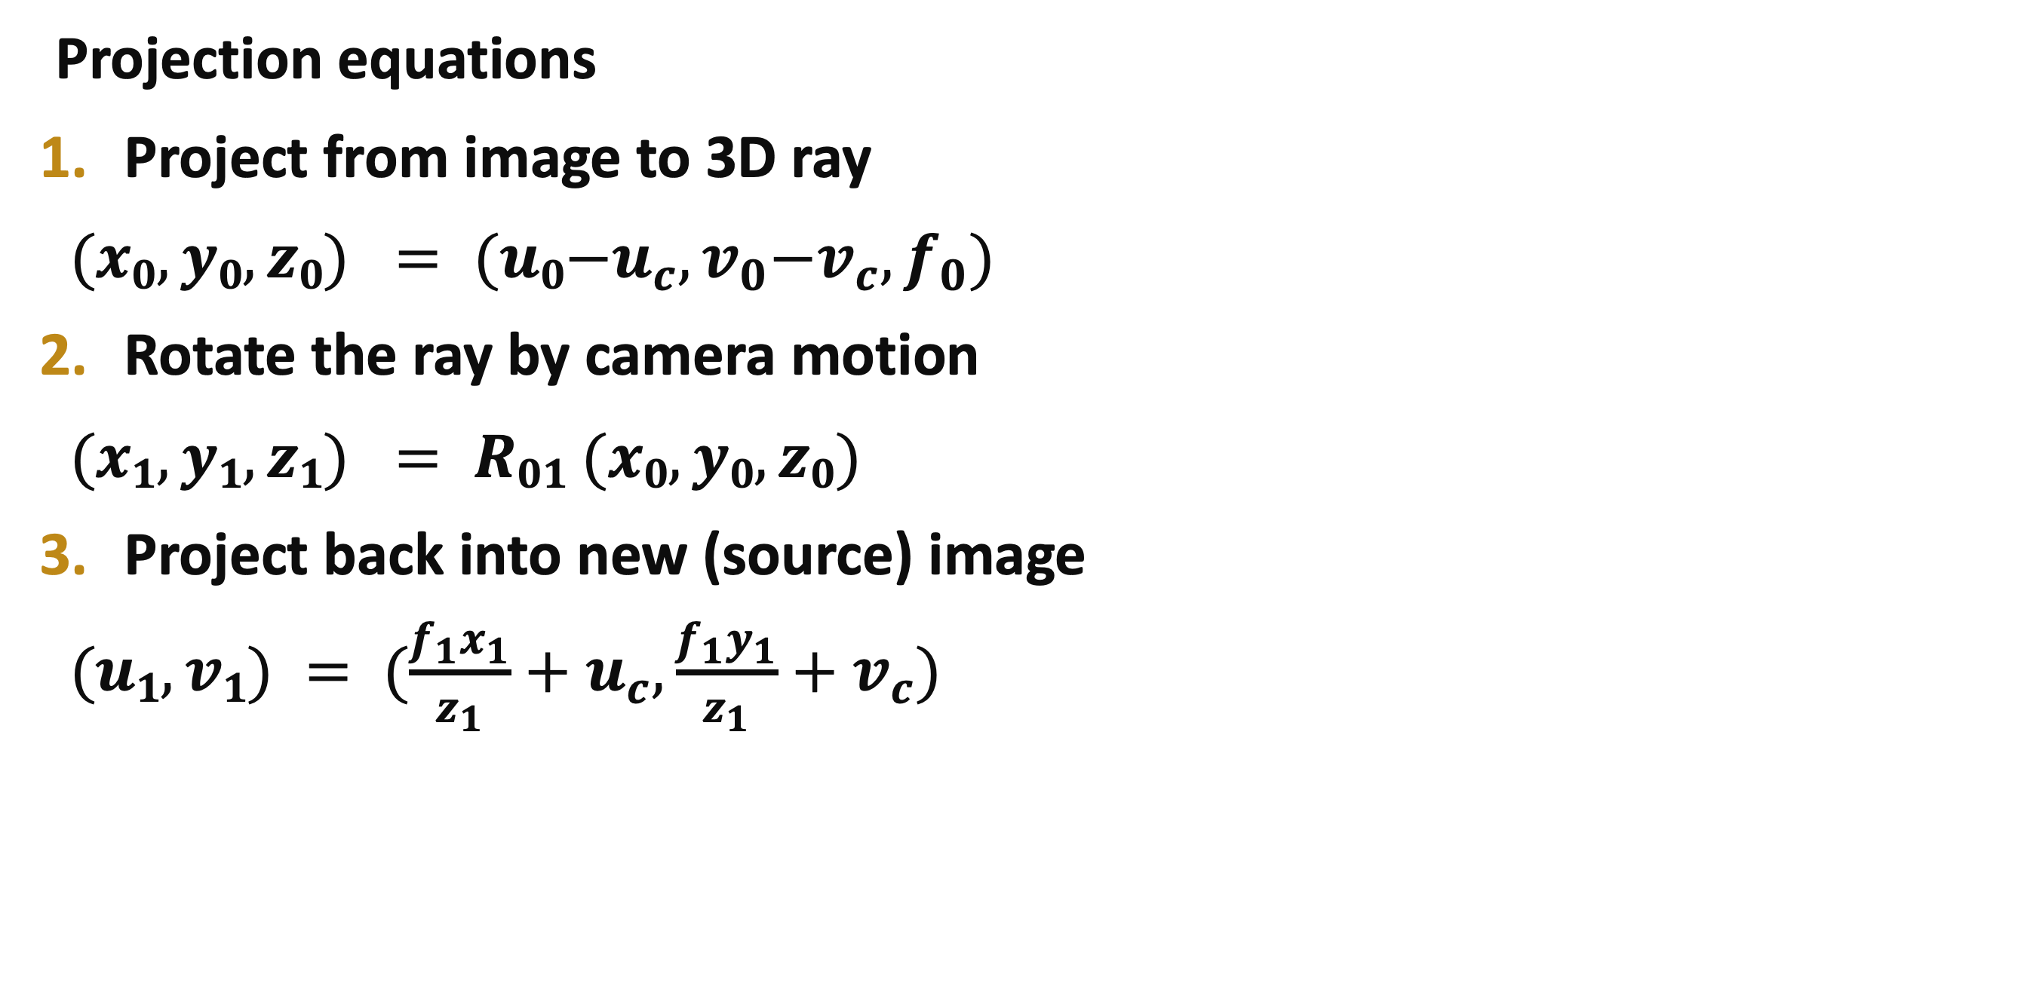
Rotational mosaic
Projection equations
Project from image to 3D ray
$(x0,y0,z0) = (u0{{−u}_{c},v}_{0}{−v}_{c},f_{0})$
Rotate the ray by camera motion
$(x1,y1,z1) = R01 (x0,y0,z0)$
Project back into new (source) image
$(u1,v1) = (\frac{f_{1}x_{1}}{z_{1}}+u_{c},\frac{f_{1}y_{1}}{z_{1}}+v_{c})$

Slide 36
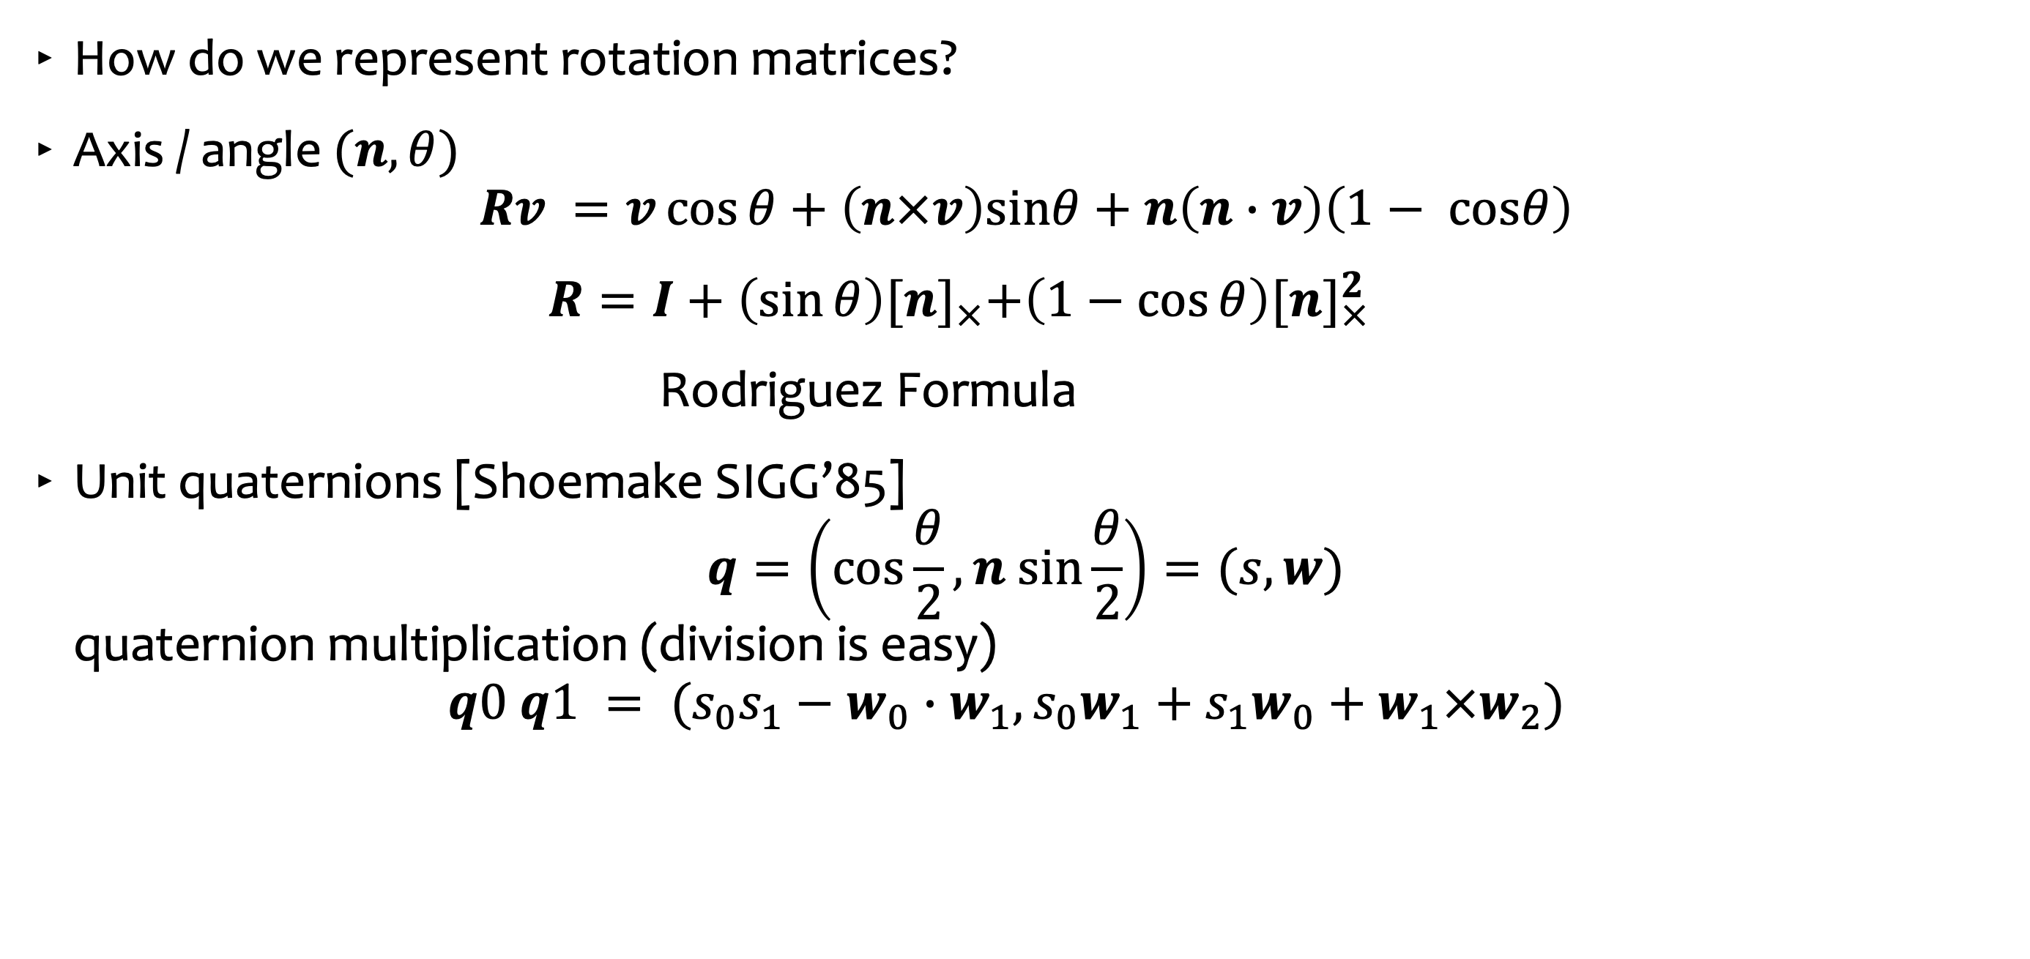
Rotations and quaternions
How do we represent rotation matrices?
Axis / angle $(n,θ)$ $Rv =v\cos{θ}+\left(n×v\right)sinθ+n\left(n∙v\right)\left(1− cosθ\right)$
$R=I+\left(\sin{θ}\right){[n]}_{×}+\left(1−\cos{θ}\right)[{n]}_{×}^{2}$
Rodriguez Formula
Unit quaternions [Shoemake SIGG’85] $q=\left(\cos{\frac{θ}{2}},n sin\frac{θ}{2}\right)=(s,w)$ quaternion multiplication (division is easy) $q0 q1 = (s_{0}s_{1}−w_{0}∙w_{1},s_{0}w_{1}+s_{1}w_{0}+w_{1}×w_{2})$

Slide 37
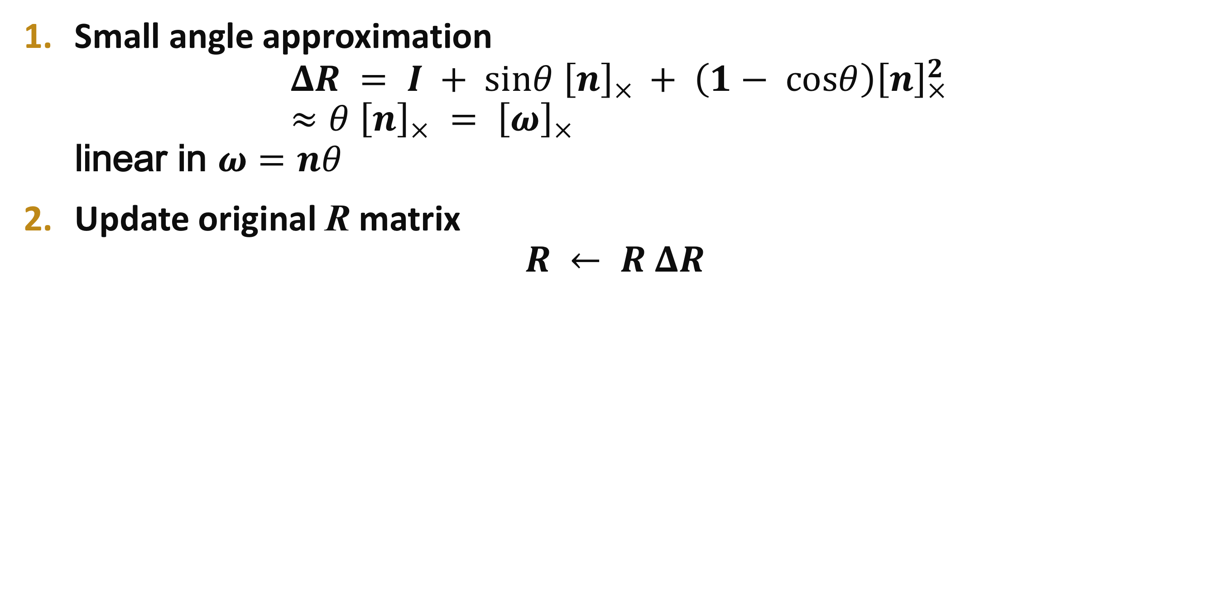
Incremental rotation update
Small angle approximation $ΔR = I + sinθ {\left[n\right]}_{×} + \left(1− cosθ\right){\left[n\right]}_{×}^{2}$ $≈θ {\left[n\right]}_{×} = {\left[ω\right]}_{×}$ linear in $ω=nθ$
Update original R matrix $R ← R ΔR$

Slide 38
Image Mosaics (stitching)
[Szeliski & Shum, SIGGRAPH’97]
[Szeliski, FnT CVCG, 2006]

Slide 39
Image Mosaic

Slide 40
Image Mosaics (stitching)
Blend together several overlapping images into one seamless mosaic (composite)
+
+ … +
=

Slide 41
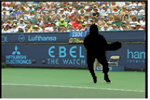
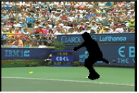
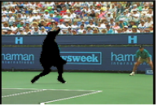
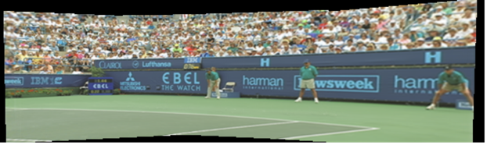
Mosaics for Video Coding
Convert masked images into a background sprite for content-based coding
+ + + =

Slide 42
Establishing correspondences
Direct method:
Use generalization of affine motion model [Szeliski & Shum ’97]
Feature-based method
Extract features, match, find consisten inliers [Lowe ICCV’99; Schmid ICCV’98, Brown&Lowe ICCV’2003]
Compute R from correspondences (absolute orientation)

Slide 43
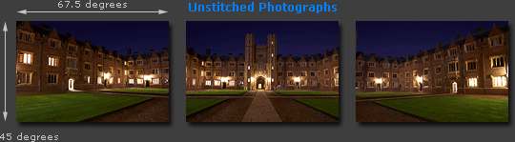
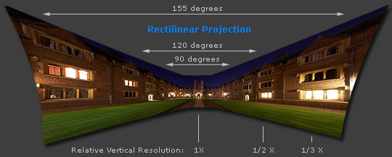
Panorama: What if you want a 360° field of view?
Adopted from http://www.cambridgeincolour.com/tutorials/image-projections.htm
Notes:
http://www.cambridgeincolour.com/tutorials/image-projections.htm

Slide 44
Panoramas
What if you want a 360° field of view?
mosaic Projection Cylinder

Slide 45
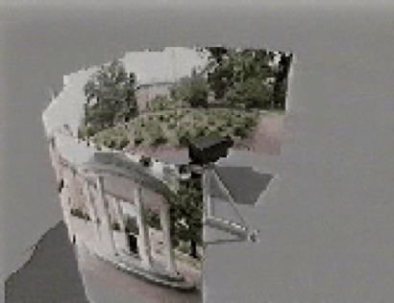
Cylindrical Panoramas
Steps
Reproject each image onto a cylinder
Blend
Output the resulting mosaic

Slide 46
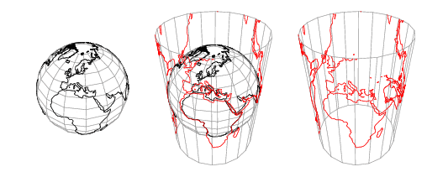
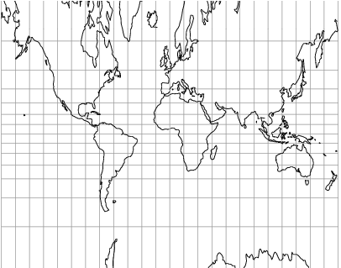
Cylindrical projection

Slide 47
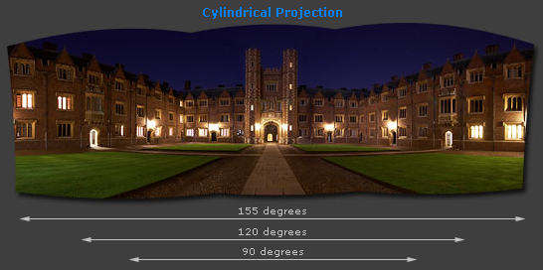
Cylindrical projection
Adopted from http://www.cambridgeincolour.com/tutorials/image-projections.htm
Notes:
http://www.cambridgeincolour.com/tutorials/image-projections.htm

Slide 48
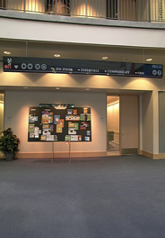
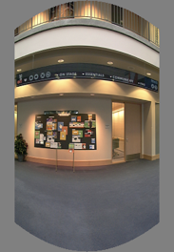
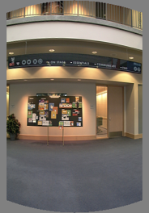

Cylindrical Panoramas
Map image to cylindrical or spherical coordinates
need known focal length
Image 384x300
f = 180 (pixels)
f = 280
f = 380
Notes:
Therefore, it is desirable if the global motion model we need to recover is translation, which has only two parameters. It turns out that for a pure panning motion, if we convert two images to their cylindrical maps with known focal length, the relationship between them can be represented by a translation.
Here is an example of how cylindrical maps are constructed with differently with f’s. Note how straight lines are curved.
Similarly, we can map an image to its longitude/latitude spherical coordinates as well if f is given.

Slide 49








Cylindrical reprojection
top-down view
Focal length – the dirty secret…
Image 384x300
f = 180 (pixels)
f = 280
f = 380
Notes:
Therefore, it is desirable if the global motion model we need to recover is translation, which has only two parameters. It turns out that for a pure panning motion, if we convert two images to their cylindrical maps with known focal length, the relationship between them can be represented by a translation.
Here is an example of how cylindrical maps are constructed with differently with f’s. Note how straight lines are curved.
Similarly, we can map an image to its longitude/latitude spherical coordinates as well if f is given.

Slide 50
Determining the focal length
Initialize from homography H (see text or [SzSh’97])
Use camera’s EXIF tags (approx.)
Use a tape measure
1m
4m

Slide 51

A simple method for estimating f
Or, you can use other software, such as AutoStich, to help.
w
p
d
f

Slide 52










Cylindrical projection
$$(X,Y,Z)$$
Map 3D point (X,Y,Z) onto cylinder
Convert to cylindrical coordinates
Convert to cylindrical image coordinates
s defines size of the final image
$$\left(\hat{x},\hat{y},\hat{z}\right)=\frac{1}{\sqrt{X^{2}+Z^{2}}}(X,Y,Z)$$
$$(\hat{x},\hat{y},\hat{z})$$
Y
Z
X
$$\left(\sin{θ},h,\cos{θ}\right)=\left(\hat{x},\hat{y},\hat{z}\right)$$
unit cylinder
$$\left(\tilde{x},\tilde{y}\right)=\left(sθ,sh\right)+({\tilde{x}}_{c},{\tilde{y}}_{c})$$
$$h$$
$$({\tilde{x}}_{c},{\tilde{y}}_{c})$$
$$θ$$
unwrapped cylinder
$$\tilde{y}$$
$$\tilde{x}$$
cylindrical image

Slide 53

Cylindrical warping
Given focal length f and image center (x_{c},y_{c})
(X,Y,Z)
(sinθ,h,cosθ)
Y
Z
X

Slide 54

Spherical warping
Given focal length f and image center $(xc,yc)$
φ
(x,y,z)
cos φ
(sinθcosφ,cosθcosφ,sinφ)
sin φ
Y
Z
cos θ cos φ
X

Slide 55
3D rotation
Rotate image before placing on unrolled sphere
φ
(x,y,z)
cos φ
sin φ
(sinθcosφ,cosθcosφ,sinφ)
Y
Z
cos θ cos φ
X
p = R p
_ _
_ _

Slide 56



Radial distortion
Correct for “bending” in wide field of view lenses

Slide 57


Fisheye lens
Extreme “bending” in ultra-wide fields of view

Slide 58

Image Stitching
Align the images over each other
camera pan ↔ translation on cylinder
Blend the images together

Slide 59

Matching features
What do we do about the “bad” matches?

Slide 60
RAndom SAmple Consensus
Select one match, count inliers

Slide 61
Least squares fit
Find “average” translation vector

Slide 62

RANSAC for estimating homography
RANSAC loop:
Select four feature pairs (at random)
Compute homography $H$
Compute inliers where $\left|\left|p_{i}^{′},Hp_{i}\right|\right|<ε$
Keep largest set of inliers
Re-compute least-squares $H$ estimate using all of the inliers

Slide 63
RANSAC: 1D Line Fitting
least squares
line

Slide 64
RANSAC: 1D Line Fitting

Slide 65
RANSAC: 1D Line Fitting
RANSAC
line

Slide 66
Assembling the panorama
Stitch pairs together, blend, then crop

Slide 67
Problem: Drift
Error accumulation
small (vertical) errors accumulate over time
apply correction so that sum = 0 (for 360° pan.)

Slide 68
Problem: Drift
Solution
add another copy of first image at the end
this gives a constraint: yn = y1
there are a bunch of ways to solve this problem
add displacement of (y1 – yn)/(n -1) to each image after the first
compute a global warp: y’ = y + ax
run a big optimization problem, incorporating this constraint
best solution, but more complicated
known as “bundle adjustment”
(x₁,y₁)
(x_{n},y_{n})
copy of first image

Slide 69


End-to-end alignment and crop

Slide 70

Rectangling panoramas
video

Slide 71

Full-view (360° spherical) panoramas

Slide 72






Full-view Panorama
+
+
+
+
Richard Szeliski
Image Stitching

Slide 73





Texture Mapped Model

Slide 74
Global alignment
Register all pairwise overlapping images
Use a 3D rotation model (one R per image)
Use direct alignment (patch centers) or feature based
Infer overlaps based on previous matches (incremental)
Optionally discover which images overlap other images using feature selection (RANSAC)

Slide 75
Recognizing Panoramas
Matthew Brown & David Lowe
ICCV’2003

Slide 76




























Recognizing Panoramas
[Brown & Lowe, ICCV’03]

Slide 77
Finding the panoramas

Slide 78
Finding the panoramas

Slide 79
Finding the panoramas

Slide 80
Finding the panoramas

Slide 81

Fully automated 2D stitching
Demo

Slide 82

Get you own free copy
http://get.live.com/photogallery/overview

Slide 83
Rec.pano.: system components
Feature detection and description
more uniform point density
Fast matching (hash table)
RANSAC filtering of matches
Intensity-based verification
Incremental bundle adjustment
[M. Brown, R. Szeliski, and S. Winder. Multi-image matching using multi-scale oriented patches, CVPR'2005]

Slide 84
Multi-Scale Oriented Patches
Interest points
Multi-scale Harris corners
Orientation from blurred gradient
Geometrically invariant to similarity transforms
Descriptor vector
Bias/gain normalized sampling of local patch (8x8)
Photometrically invariant to affine changes in intensity

Slide 85





Feature irregularities
Distribute points evenly over the image

Slide 86

Descriptor Vector
Orientation = blurred gradient
Similarity Invariant Frame
Scale-space position (x, y, s) + orientation (θ)

Slide 87




Probabilistic Feature Matching

Slide 88




RANSAC motion model

Slide 89


RANSAC motion model

Slide 90

RANSAC motion model

Slide 91


Probabilistic model for verification

Slide 92
How well does this work?
Test on 100s of examples…

Slide 93
How well does this work?
Test on 100s of examples…
…still too many failures (5-10%) for consumer application

Slide 94


Matching Mistakes: False Positive

Slide 95


Matching Mistakes: False Positive

Slide 96

Matching Mistake: False Negative
Moving objects: large areas of disagreement

Slide 97


Matching Mistakes
Accidental alignment
repeated / similar regions
Failed alignments
moving objects / parallax
low overlap
“feature-less” regions (more variety?)
No 100% reliable algorithm?

Slide 98
How can we fix these?
Tune the feature detector
Tune the feature matcher (cost metric)
Tune the RANSAC stage (motion model)
Tune the verification stage
Use “higher-level” knowledge
e.g., typical camera motions
→ Sounds like a big “learning” problem
Need a large training/test data set (panoramas)

Slide 99
Image Blending

Slide 100
Image feathering
Weight each image proportional to its distance from the edge (distance map [Danielsson, CVGIP 1980]
1. Generate weight map for each image
2. Sum up all of the weights and divide by sum: weights sum up to 1: wi’ = wi / ( ∑i wi)

Slide 101



Image Feathering

Slide 102



Feathering
+
1
=
1
0
0

Slide 103


Effect of window size
1
left
1
right
0
0

Slide 104


Effect of window size
1
1
0
0

Slide 105

Good window size
1
0
“Optimal” window: smooth but not ghosted
Doesn’t always work...

Slide 106



Pyramid Blending
Burt, P. J. and Adelson, E. H., A multiresolution spline with applications to image mosaics, ACM Transactions on Graphics, 42(4), October 1983, 217-236.

Slide 107



Laplacian
level
4
Laplacian
level
2
Laplacian
level
0
left pyramid
right pyramid
blended pyramid

Slide 108
Laplacian image blend
Compute Laplacian pyramid
Compute Gaussian pyramid on weight image (can put this in A channel)
Blend Laplacians using Gaussian blurred weights
Reconstruct the final image
Q: How do we compute the original weights?
A: For horizontal panorama, use mid-lines
Q: How about for a general “3D” panorama?

Slide 109

Weight selection (3D panorama)
Idea: use original feather weights to select strongest contributing image
Can be implemented using L-∞ norm: ($p = 10$)
$w_{i}^{′}={\left(\frac{w_{i}^{p}}{\sum_{i}{w_{i}^{p}}}\right)}^{\frac{1}{p}}$

Slide 110

Poisson Image Editing
Blend the gradients of the two images, then integrate
For more info: Perez et al, SIGGRAPH 2003

Slide 111

De-Ghosting

Slide 112

Local alignment (deghosting)
Use local optic flow to compensate for small motions [Shum & Szeliski, ICCV’98]

Slide 113

Local alignment (deghosting)
Use local optic flow to compensate for radial distortion [Shum & Szeliski, ICCV’98]

Slide 114

Region-based de-ghosting
Select only one image in regions-of-difference using weighted vertex cover [Uyttendaele et al., CVPR’01]

Slide 115

Region-based de-ghosting
Select only one image in regions-of-difference using weighted vertex cover [Uyttendaele et al., CVPR’01]

Slide 116
Cutout-based de-ghosting
Select only one image per output pixel, using spatial continuity
Blend across seams using gradient continuity (“Poisson blending”) [Agarwala et al., SG’2004]

Slide 117

Cutout-based compositing
Photomontage [Agarwala et al., SG’2004]
Interactively blend different images: group portraits

Slide 118

Cutout-based compositing
Photomontage [Agarwala et al., SG’2004]
Interactively blend different images: focus settings

Slide 119

Cutout-based compositing
Photomontage [Agarwala et al., SG’2004]
Interactively blend different images: people’s faces

